Slide 1
Fair Weather Car Crashing
An Analysis of Weather’s Impact on Road Collisions in Bristol

Slide 2

Scope of the project
Analyse collision data in Bristol
Compare it to weather data
Create a model to predict crashes
martyna-bober-VdpUul8b_f8-unsplash
Notes:
martyna-bober-VdpUul8b_f8-unsplash

Slide 3
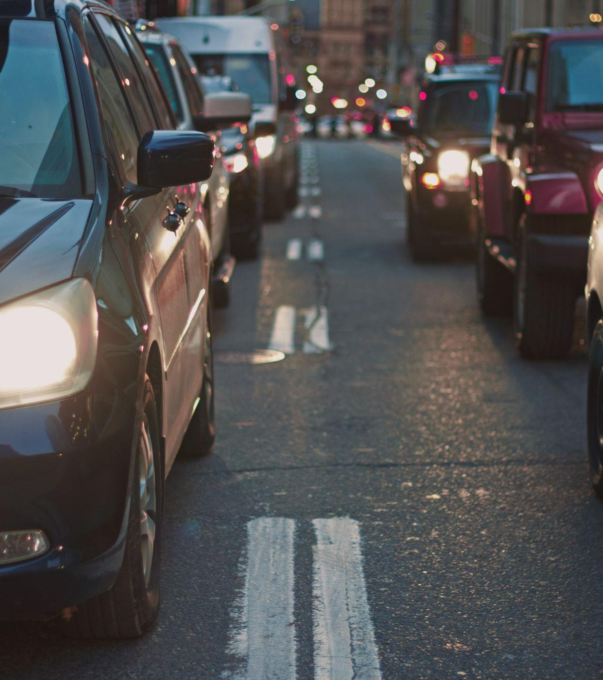
Why?
Bristol is busy
Crashes make it worse
Emergency services
nabeel-syed-Jk3-Uhdwjcs-unsplash
Notes:
nabeel-syed-Jk3-Uhdwjcs-unsplash

Slide 4
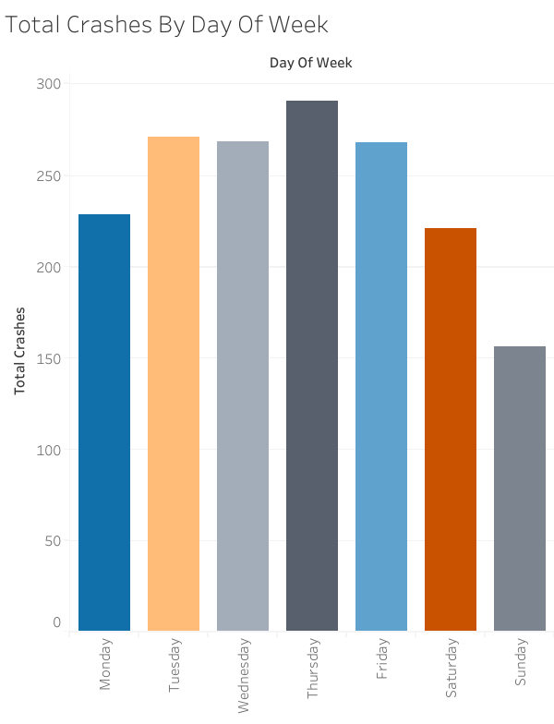
Sources
STATS19 data set from the department for transport.
Collected by a Police Officer at the scene
Weather from Visual Crossing

Slide 5
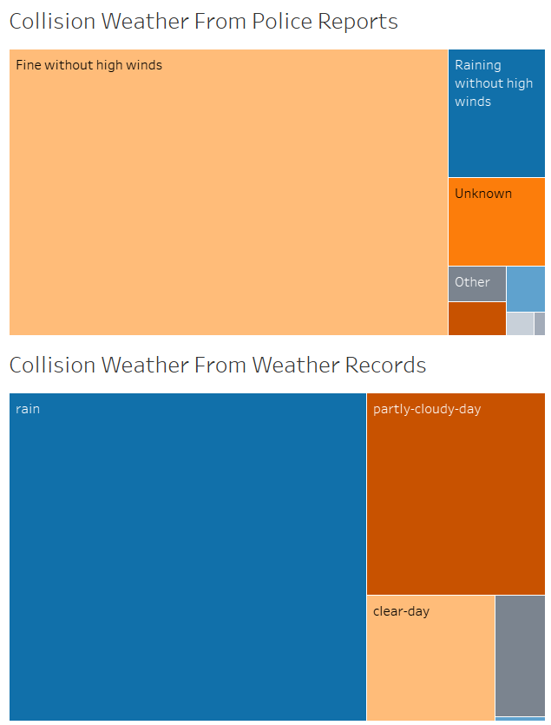
Some Questionable Data
Both tree maps refer to the same data
Police report shows that the weather at collisions is mostly fine
Weather website shows mostly rain

Slide 6
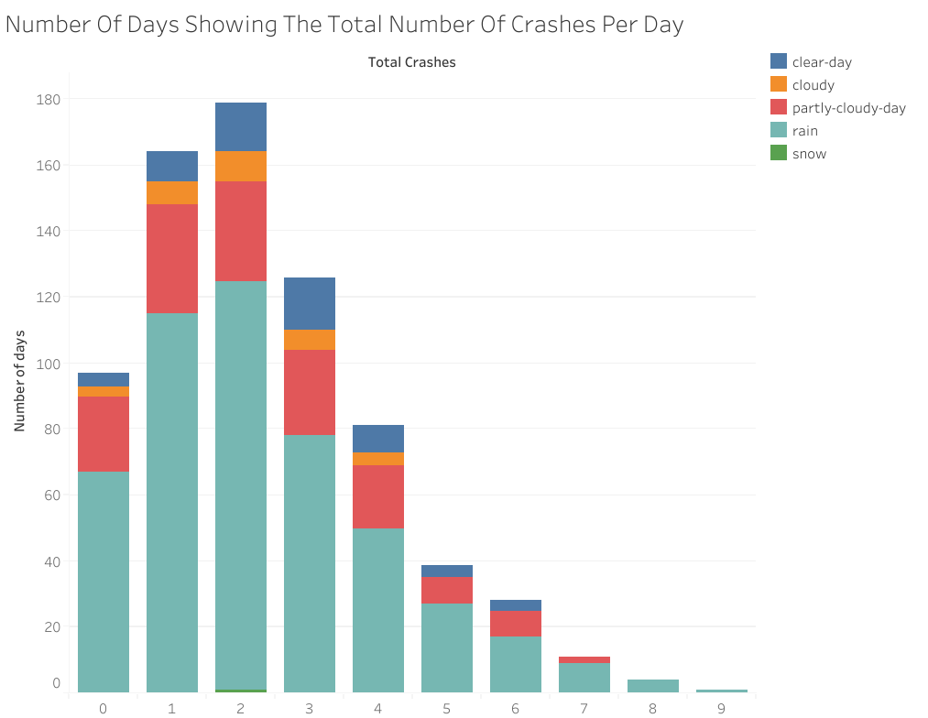
Daily Crashes
Most common - 2 crashes per day
Colour shows weather icon
Influence isn’t obvious

Slide 7
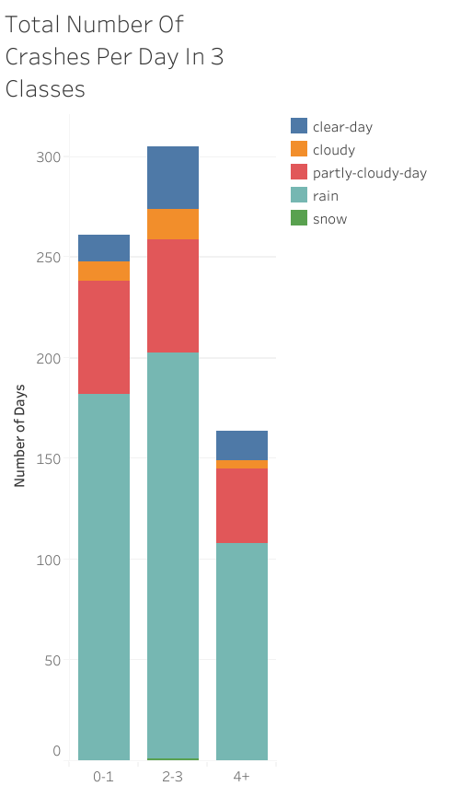
Grouping for modelling
3 buckets simpler than 9
Weather ratios look more promising
Notes:
if [Total Crashes] = 1 or [Total Crashes] = 2 or [Total Crashes] = 3 then '1-3'
elseif [Total Crashes] = 4 or [Total Crashes] = 5 or [Total Crashes] = 6 then '4-6'
elseif [Total Crashes] = 7 or [Total Crashes] = 8 or [Total Crashes] = 9 then '7-9'
else '0'
end
if [Total Crashes] = 0 or [Total Crashes] = 1 then '0-1'
elseif [Total Crashes] = 2 or [Total Crashes] = 3 then '2-3'
else '4+'
end

Slide 8
The model
The contenders:
Decision Tree
Logistic Regression
Random Forest
The criteria:
Maximise accuracy
Cope with smallish data set
Minimise overfit on the train
Avoid underfit

Slide 9

Assumptions
Same weather all day
Time of crash not used
Accuracy of data (police and weather)
Speed limit didn’t play a part
Similar weightings in the crash groups
randy-jacob-A1HC8M5DCQc-unsplash
Notes:
randy-jacob-A1HC8M5DCQc-unsplash

Slide 10
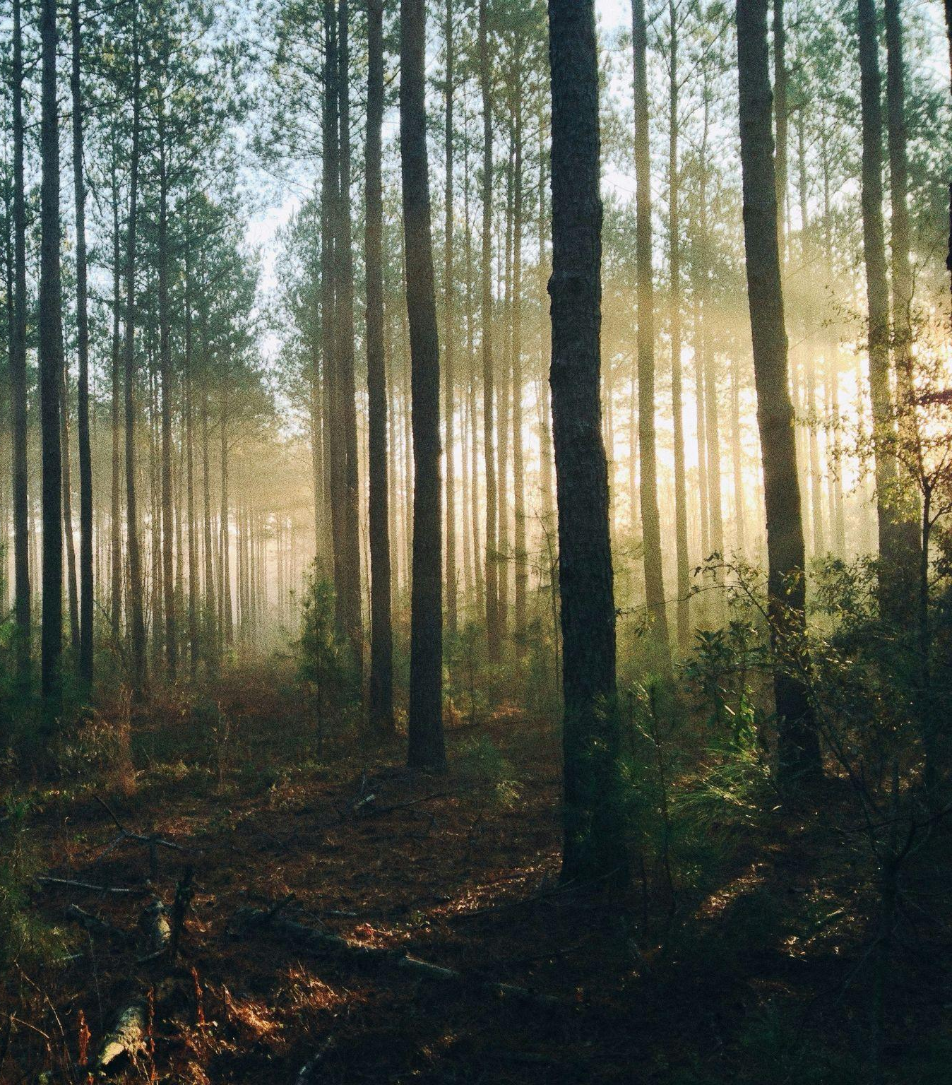
Random Forest
GridSearch CV provided:
max_depth=2
max_features=7
min_samples_leaf=4
min_samples_split=10
n_estimators=100
steven-kamenar-MMJx78V7xS8-unsplash
Notes:
steven-kamenar-MMJx78V7xS8-unsplash

Slide 11

How did it perform?
Accuracy on train was 49.1%
Accuracy on test was 49.3%
Guessing would give 33%
nicolas-hoizey--4trKf0Kbow-unsplash
Notes:
nicolas-hoizey--4trKf0Kbow-unsplash

Slide 12
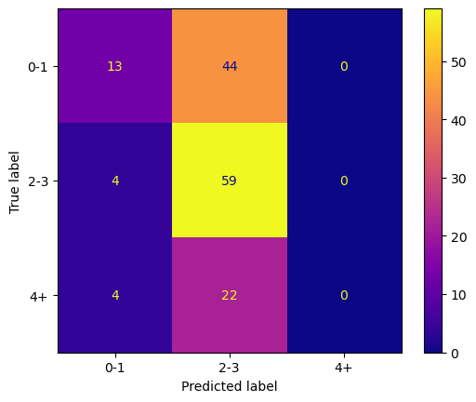
Limitations
No predictions of 4+ despite having some in the train.
Many false predictions of 2-3 crashes
Imbalanced classes
Data size could be an issue

Slide 13
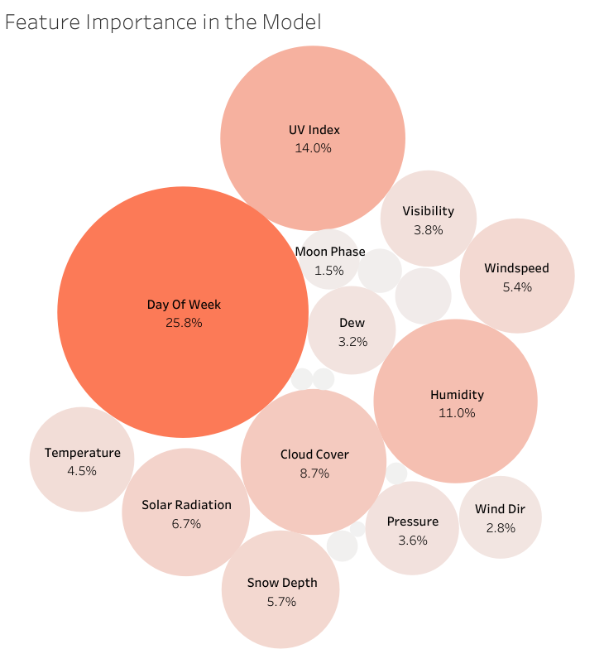
Does It Depend On The Moon
Day of the week has a significant effect
UV index, humidity also affect the model

Slide 14

What could I have changed?
More data-
More years
More locations
Increased frequency of weather data
Tried different models
Something continuous
Time series
kevin-jarrett-t3d22GqvUqs-unsplash
Notes:
kevin-jarrett-t3d22GqvUqs-unsplash

Slide 15

Key Findings
Day of the week has the biggest impact on crashes per day
Better weather seems to encourage more crashes
Many other factors that determine crashes
nathan-riley-iOMkcADNoq8-unsplash
Notes:
nathan-riley-iOMkcADNoq8-unsplash

